Slide 1

Supply Chain Visibility
Bayer & One Network Partner Summit
April 2024

Slide 2
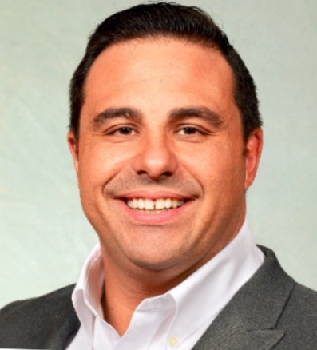







Meet Your Speakers
Johnny Ivanyi
German Gies
Oliver Nagy
Dan
Lemons
Alexandra
Howell
Erik Van der Merwe
Global Logistics Lead
Global Logistics Project Lead
Global Logistics Project Implementation Lead
VP, Partner Network Services
Partner Onboarding Lead
Lead Solution Architect

Slide 3
AGENDA
EXECUTIVE SUMMARY
PARTNER COMMUNICATION AND CONNECTIONS
DIGITAL SUPPLY CHAIN – ONE NETWORK
PARTNER BENEFITS & PARTNER DASHBOARD
TO BE PROCESS AND FEATURES
PARTNER ONBOARDING TO ONE NETWORK
CURRENT ACTIONS
HIGH LEVEL TIMELINE & MILESTONES
CONTACTS US

Slide 4
EXECUTIVE SUMMARY - Scope & Goals
SmartCenter and One Network
SmartCenter is a Global Bayer Supply Chain Platform that consolidates disparate data sources into our Crop Science Data Warehouse. One Network integrates our SAP ERP, FourKites, and transportation systems with our data warehouse and our upstream logistics activities to provide End-to-End visibility, actionability, data analytics, KPIs, and alerts to all partners.
Why have you been invited?
As a valued partner with Bayer Crop Protection, your organization is: Raw Material Supplier: Supplying Raw Materials Supplying Active Ingredients Supplying Formulated Materials Or Logistics Service Provider: Upstream Material Movement - 1st, 2nd, 3rd Leg of Transportation Domestic Intercompany Business North American Glyphosate Distribution
Bayer’s Goal
Enable partners to make better decisions… faster with better: Visibility Actionability Alerts Analytical insights … will create value for all partners. Our approach: Connecting all partners and their systems through a Digital Supply Chain NetworkTM

Slide 5
RMS - Different Maturities in terms of communication & connections
Raw Material Supplier
Currently, some Bayer suppliers are sending copies of the shipping documents to a common mailbox
  Additional request: being onboarded onto One Network and increase visibility by sharing 1st leg details
Currently, some Bayer Suppliers don’t share any information on 1st, 2nd leg or domestic transports
  New request: to be onboarded onto One Network to increase Upstream visibility
Suppliers may be on Ariba (Different Process) – no overlap with Ariba project
For our raw material suppliers, onboarding onto the One Network platform will allow the network to increase visibility on 1st & 2nd leg, as well as reducing manual workload and be part of the One Network community

Slide 6
LSP - Different Maturities in terms of communication & connections
Logistic Service Provider
Currently sharing details via EDI-API onto Bayer's TMS
  One Network won’t replace this process
  Optional possibility to use One Network platform due to all value added
Currently on Bayer's TMS without EDI. Manual process involved
  Additional request to be onboarded onto One Network and provide visibility on 3rd leg and intercompany movements and in some cases, distribution
Currently not but expected to be on Bayer's TMS. (Work-in Progress)
  If EDI being established, same as 1st scenario, if no EDI, 2nd scenario should apply
Not on Bayer's TMS
  Logistic service provider to be onboarded onto One Network to provide shipment visibility
Onboarding onto One Networks Platform will bring value to both Bayer and LSP

Slide 7










150K+
Organizations
49K+
Suppliers
Organizations connected to the network
Over 49,000 active suppliers
20K+
Carriers
5.6
Million
Transacting on the
Global Logistics Gateway
Transactions handled per day
>$1
Trillion
>300
Apps
Over 1 trillion dollars in transaction value
Fully Integrated supply chain apps. All build not purchased
54
Countries
14
Patents
Spanning 6 of 7 continents
Supply chain product patents

Slide 8




One Network- Digital Supply Chain Network and Control Tower Services
4
DYNAMIC PROCESS
ORCHESTRATION
A single, real-time platform for integrating planning and execution by orchestrating supply chain processes across partners and disparate systems.
End-to-End visibility across partners
Improved exception mgmt. by 90%
Reduced lead-time variability and improved agility
Eliminate all non- physical lead times
Single version of the truth across partners
Value for all participants
3
SEMI-AUTONOMOUS –
AI, AND PRESCRIPTIVE RESOLUTIONS
2
DIGITIZATION, VISIBILITY, PROPAGATION
1
TRANSACTION AND MASTER DATA FUSION
Integrated Data Model

Slide 9
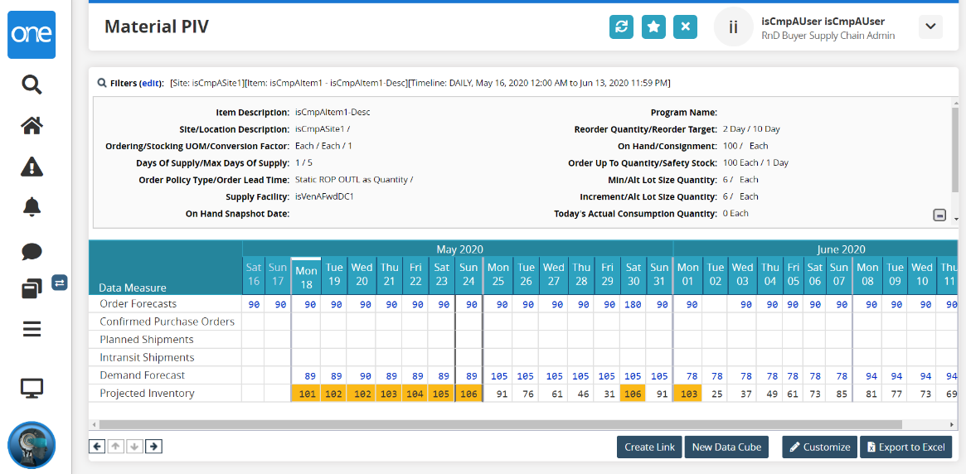
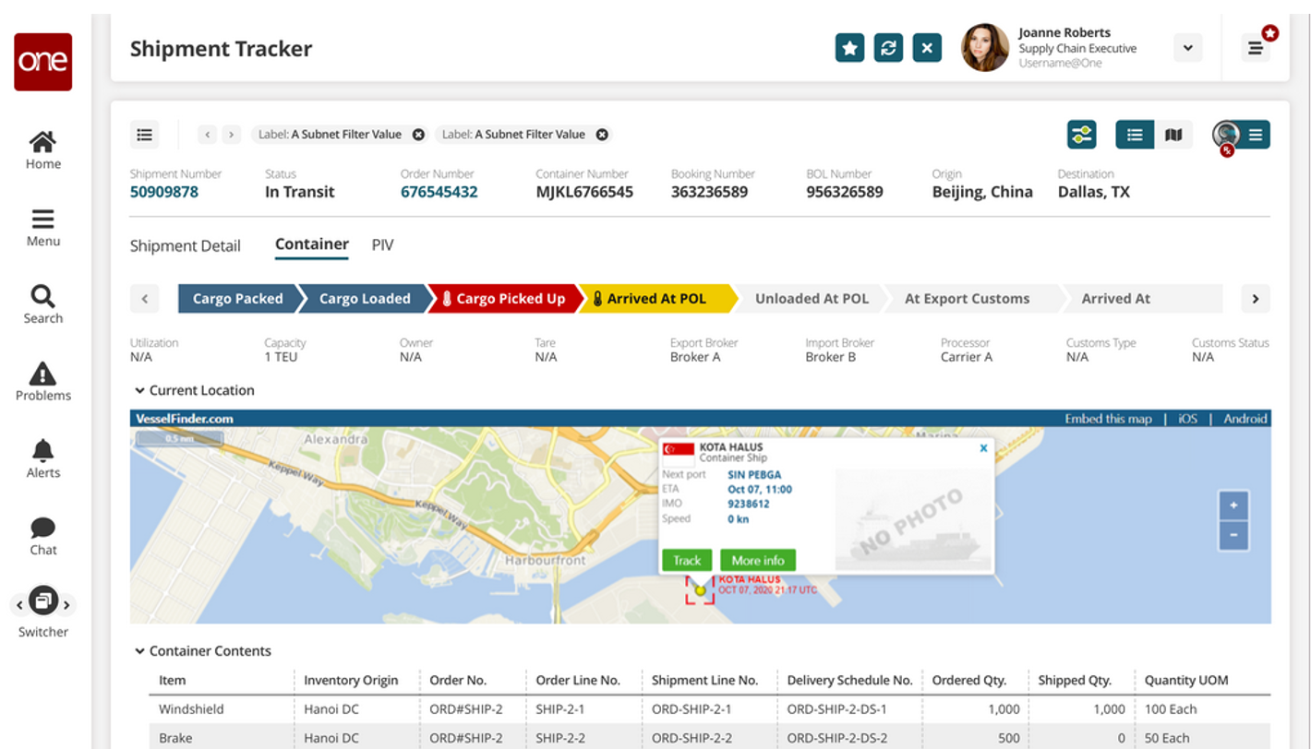
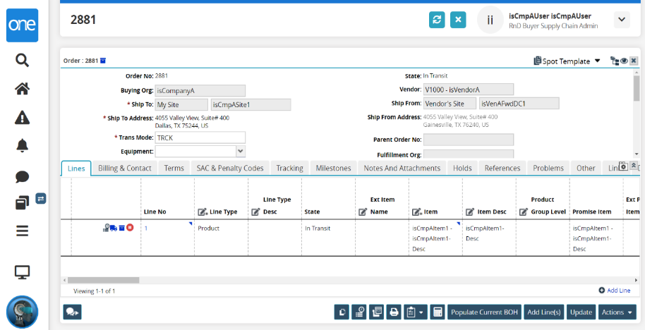
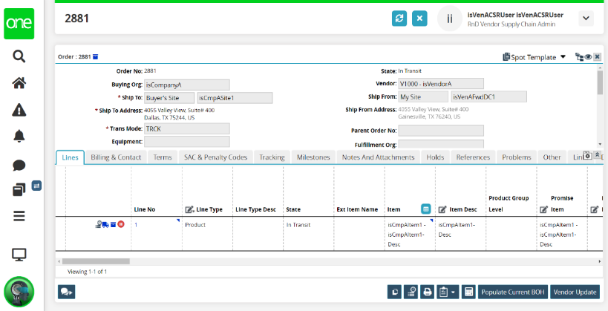
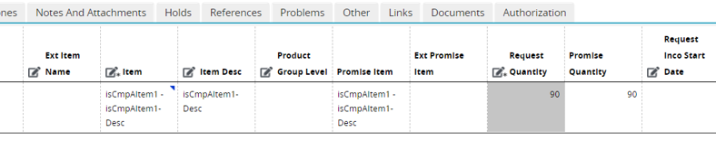
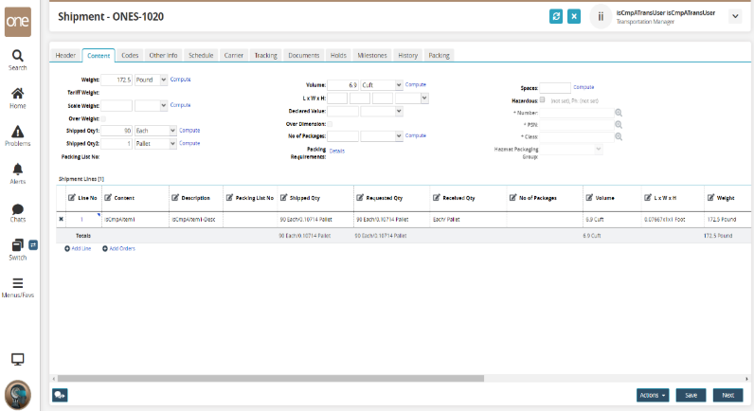
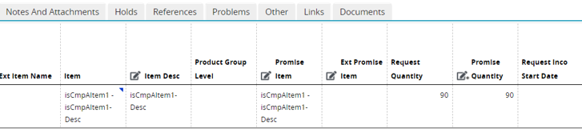
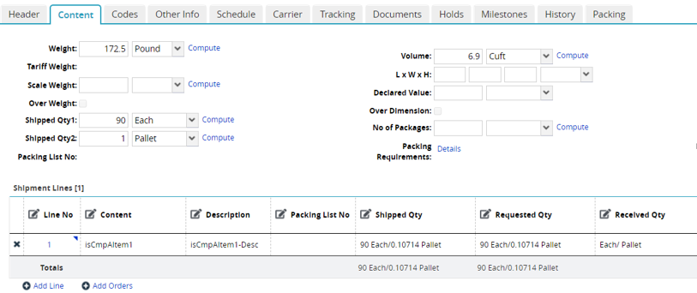
DIGITAL SUPPLY CHAIN NETWORK
is a 3-Way System
Shared View
Projected Inventory View
Order View from Bayer
Order View from RMS
Shipment View from LSP
  A “shared system” considerably reduces problem identification and resolution cycles and eliminates numerous manual and repetitive activities.

Slide 10
All Partners Benefit
Value Driver |  | Bayer | RMS | LSP
Revenue Improved sell-through through, reduction in stockouts Reduction in detention and demurrage charges Reduction in driver turnaround times
Asset Utilization Reduction in lead-time and lead-time variability: Reduction in inventory and carrying costs Reduction in carrier expedite spend Carrier Asset and Driver Utilization Reduction in dwell time

Slide 11
All Partners Benefit Cont'd
Value Driver |  | Bayer | RMS | LSP
Staff Efficiency and Effectiveness Customer Service and Transportation Scheduling: Reduction in shipment status time (emails and phone calls) Cross-functional Staff Efficiency and Effectiveness Automated reporting and analysis Historical and real-time shipment status Predicted late pick-ups and deliveries Automated Performance Scorecards

Slide 12
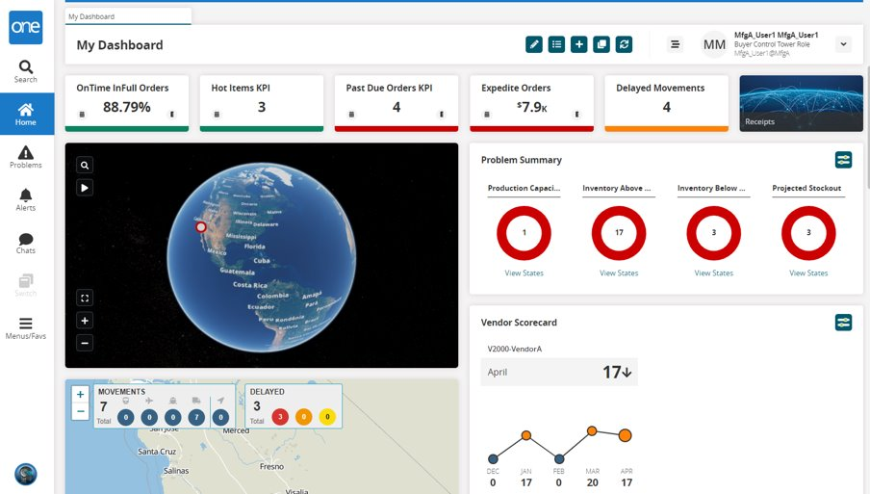
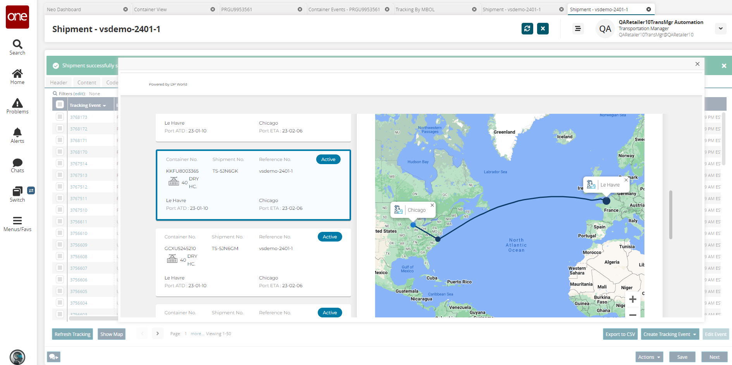
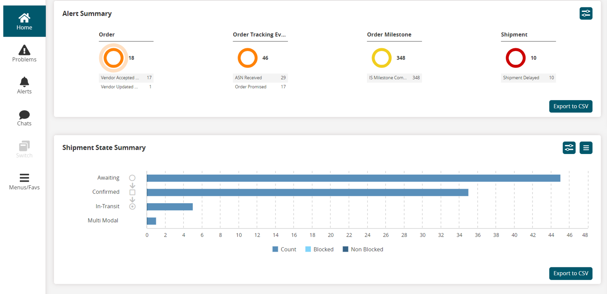
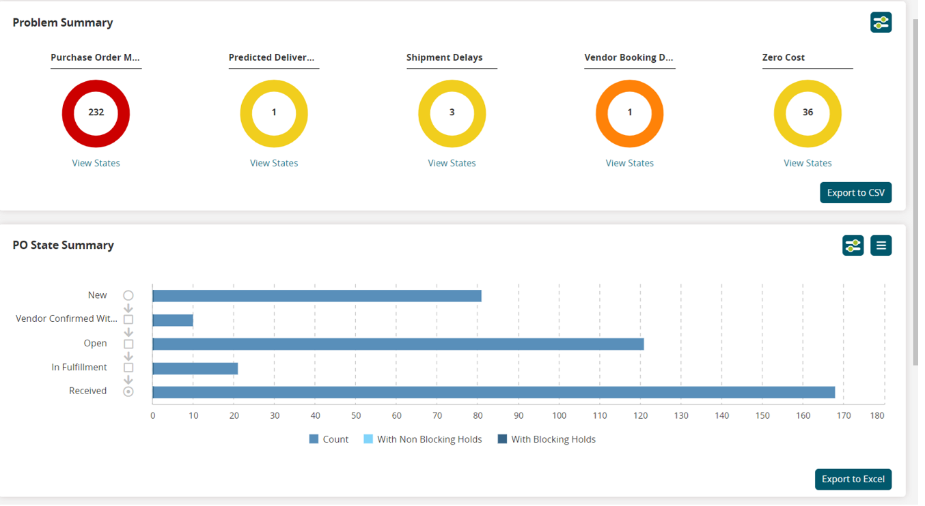
Partner Dashboards
Partner dashboards are the landing page for LSP and RMS upon logging in to One Network.
Bayer will provide specific dashboards to help partners have access to important, real-time information, enabling visibility, actionability, and performance analytics to partners.
LSP Dashboards:
Alert Summary
Problem Summary
Shipment Metrics
Shipment Summary
Scorecards
Integration Summary
Reporting Analytics
RMS Dashboards:
Alert Summary
Order Metrics
Order Summary
Shipment Summary
Scorecards
Reporting Analytics

Slide 13
TO-BE PROCESS & FEATURES
  1
  Shared standardized milestone process for SVoT reporting, alerting and collaborations (via ONE UI)
  2
  Shipment planning performed with pre-generated transaction reference for execution accuracy (via ONE UI or Integration)
  3
  Share Booking Details confirming Booking No, BOL, Port of Loading, Port of Discharge (via ONE UI or Integration), used to generate shipment legs
  4
  Provide Status Updates & Documentation for key shipping events like shipment readiness, pickup and hand-over/delivery confirmation (via ONE UI or Integration)
  5
  Exception generation, problem resolution and alerts based on real-time network updates (via ONE UI)

Slide 14
TO-BE PROCESS & FEATURES
Supplier / LSP
1
2
3
4
5
SVoT Alerts, Problems & ETAs
Shipment Planning
Shipment Booking
Pack & Ship
Status Updates
A
B
C
C
Confirmed Receipt
Bayer
Milestone Process
Booking Info
Tracking Events
Order Creation
Shipment Creation
Generate Legs
*Confirm Containers
ETA Calculation
Order Receipt
SAP
ONE
Partner Systems
EDI300; IFTMIN
ONE CSV or UI
EDI301; IFTMBC
ONE CSV or UI
EDI315;IFTSTA
ONE CSV or UI
A
B
C

Slide 15
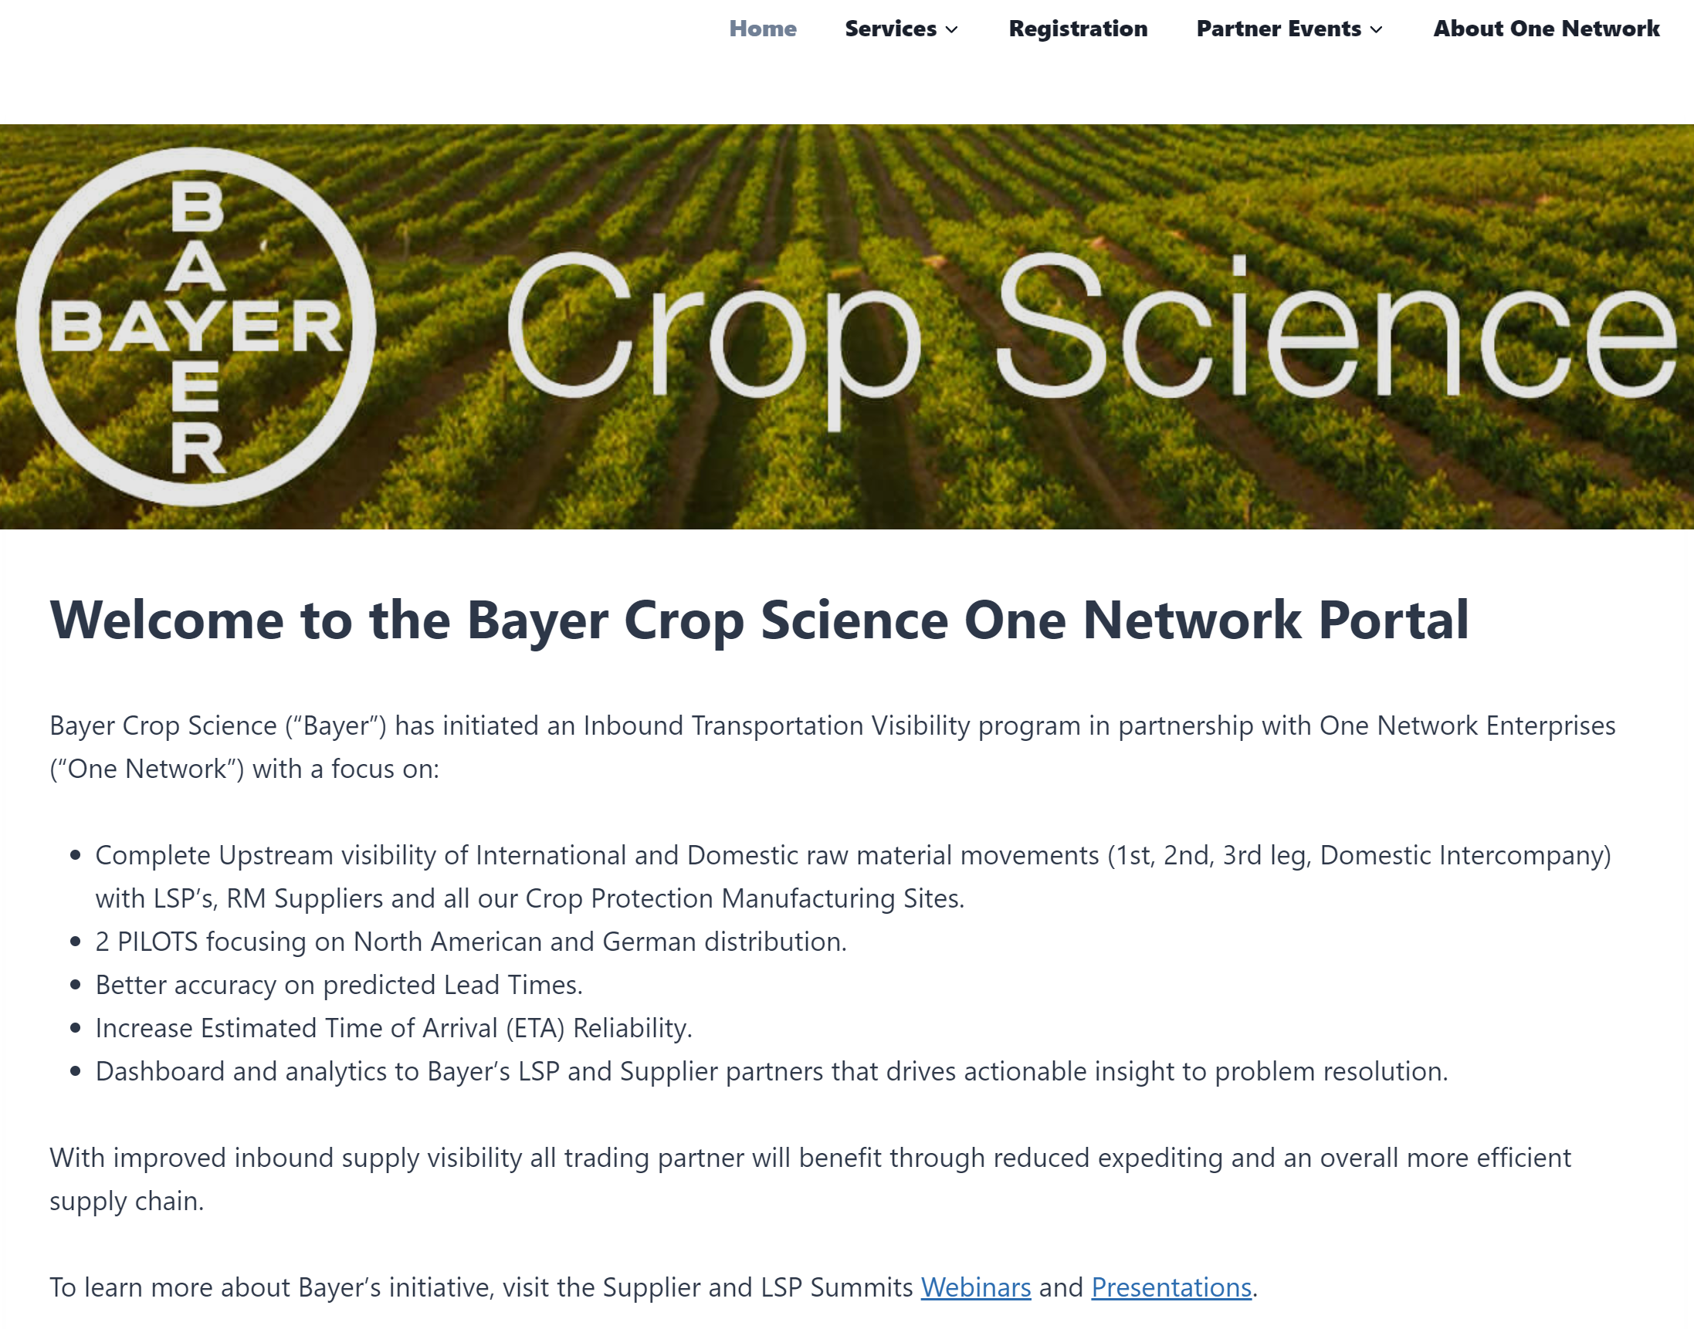
Partner Onboarding to One Network
Dedicated Partner Resource: https://bayer.onenetwork.com/
How to Register Webinar
How to Integrate Webinar
Partner Training:
  Instructor-Led Training Sessions
  Quick Training Guides
  Quick Training Videos
Frequently Asked Questions (FAQ) Guide
Project Announcements
Access to Support

Slide 16
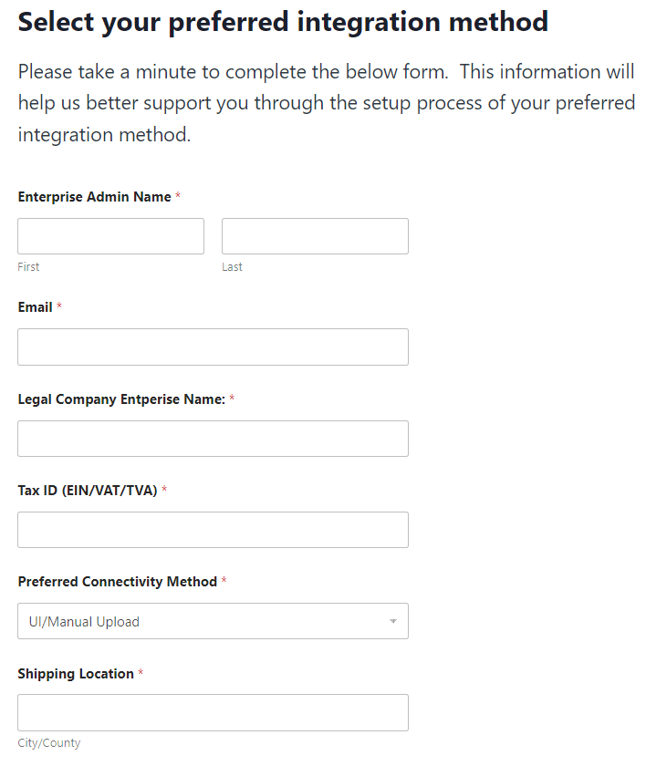
CURRENT ACTIONS
WHAT’S NEXT?
  Complete Intake Form by Submitting to the Form on the Partner Onboarding Portal (POP) Site
  RMS Supplier: https://bayer.onenetwork.com/supplier-integration/
  LSP Partner: https://bayer.onenetwork.com/carrier-integration/
  For Integrating Partners – Review the ONE Network Integration Agreement
  Partner onboarding Webinar/Registration
  Partner Training
  Q&A for Business Process Changes

Slide 17
High-level Timeline and Milestone
GO-Live
JAN 2024
Project Kick-Off
FEB 2024
MAR2024
APR 2024
MAY 2024
JUL 2024
JUN 2024
Onboarding Discussion
Prepare Bayer Partners List
ONE-Partner Vetting
Bayer Partner Announcement Email
Bayer Partner Event Email
Start Partner Onboarding
Cont. Partner Onboarding
Start Hypercare Support
Hypercare Support Cont.
Bayer Partner Event
PROD Deployment
Complete Intake Form on POP Site (By Apr-19)
Partner Onboarding Cint.
Partner Onboarding Webinar
Partner Training

Slide 18
CONTACTS US
For Any queries, please contact us :
Partner_Onboarding@onenetwork.com
Oliver.nagy@bayer.com
German.gies@bayer.com

Slide 19
Questions & Answers

Slide 20
Thank You

